Slide 1

Bittu Jaiswal - 2200290140048
ArtGallery

Slide 2
Contents
Introduction
Working Tools
Context Level Diagram
ER - Diagram
Form Design
Conclusion & References

Slide 3
Introduction
ArtGallery is a web-based application designed to fetches image data from Api about the searched thing and displays all the images in beautiful layout.
To enhance the user experience, the application provides robust search and filtering capabilities. Users can search for specific artworks, artists, or styles, and filter results based on criteria such as medium, date, and popularity

Slide 4
Working Tools
Tailwind CSS
React

Slide 5
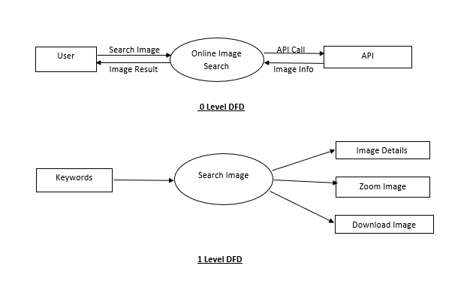
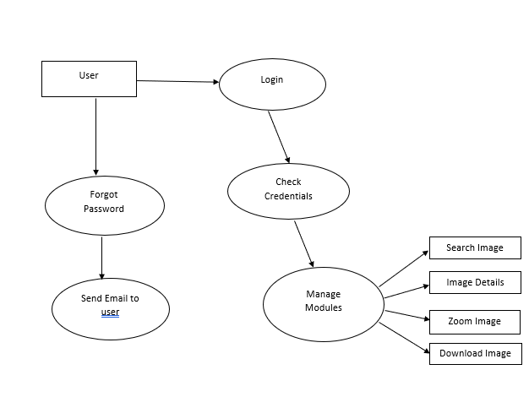
Context Level Diagram
2 Level DFD

Slide 6
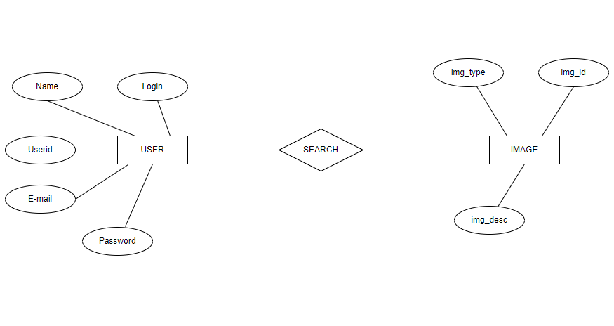
ER-DIAGRAM

Slide 7
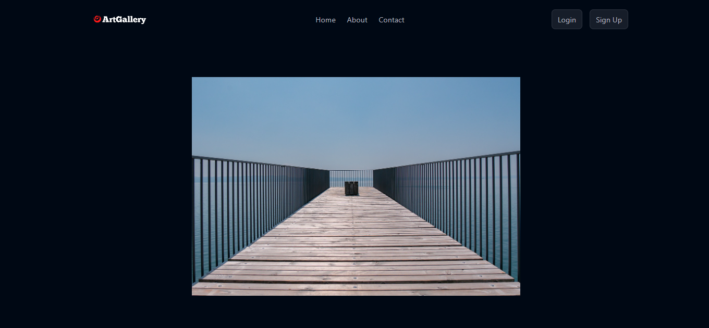
FORM DESIGN
Home

Slide 8
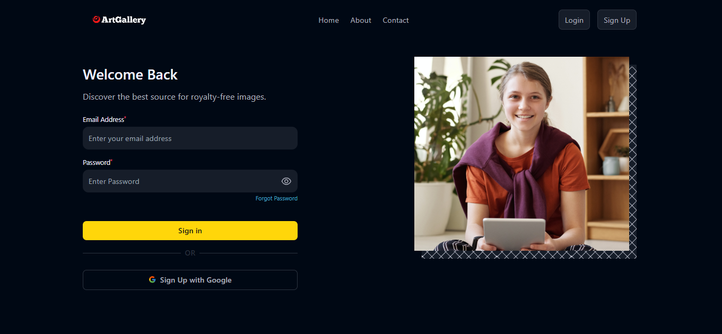
FORM DESIGN
Login

Slide 9
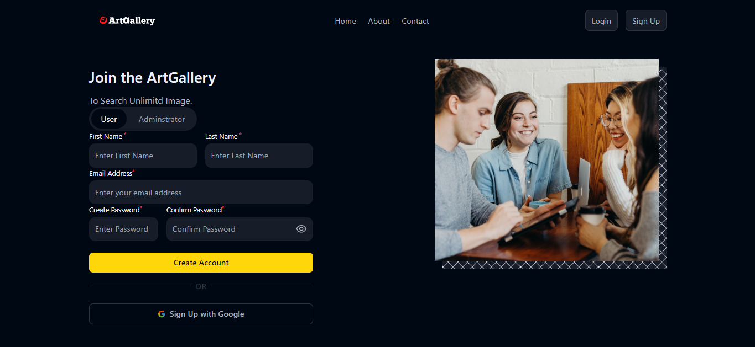
FORM DESIGN
Sign Up

Slide 10
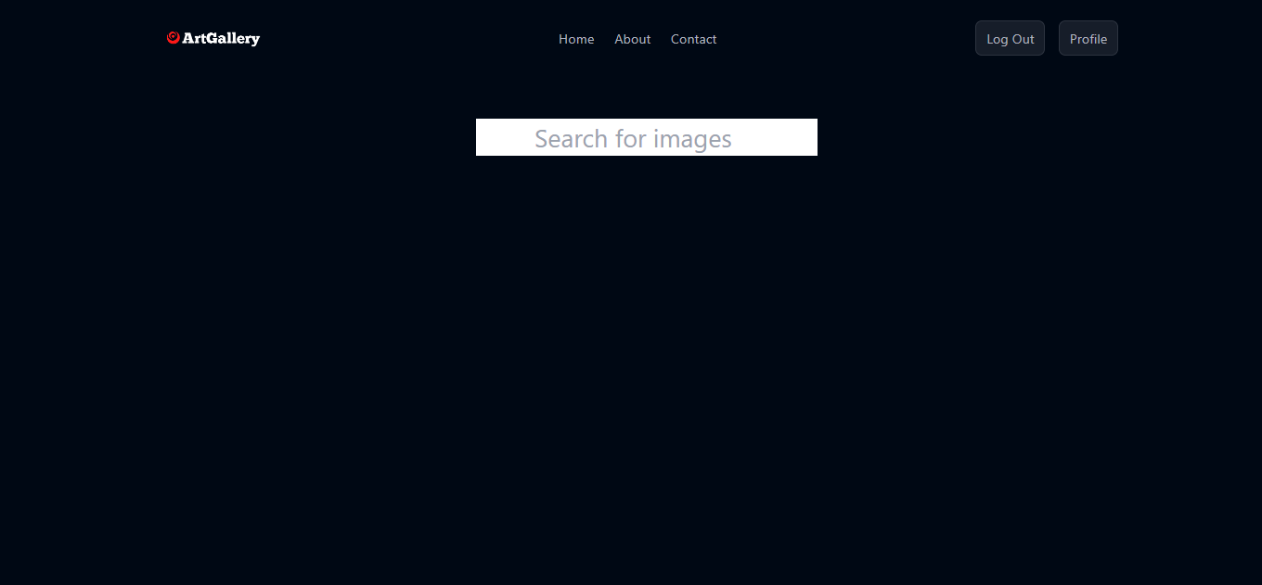
FORM DESIGN
Search Image

Slide 11
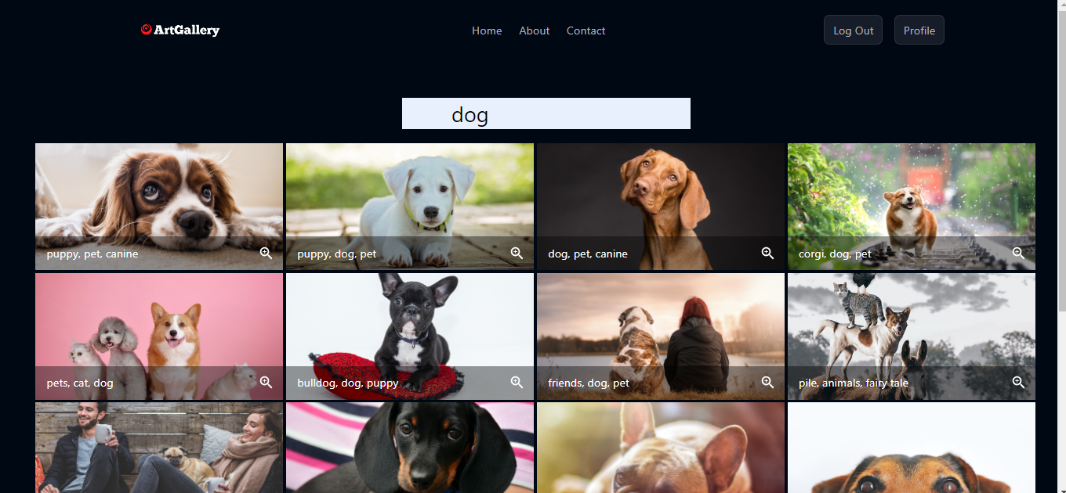
FORM DESIGN
Search Result

Slide 12
CONCLUSION & REFERNCES
We have successfully designed a project on Web Based ArtGallery.
This project is designed in React.
References
Coding phase:-
www.w3school. Com
https://react.dev/learn

Slide 13
THANK
YOU
Bittu Jaiswal - 2200290140048

